Slide 1

Celebrate Valentine’s Day with #TeamSurgery!
We’re encouraging our employees to run (or cheer on their colleagues at) the Fine Valentine Relay, taking place Sunday, February 9th, 2020 at 8:30 AM.
Participants have the option to run solo or in pairs. Solo runners can either choose to run a 4-mile or 2-mile race, while pairs will run a 4-mile race split into two 2-mile laps. Pairs must show a public display of affection (PDA) at the finish line, so make sure you and your other half aren’t afraid to get a little close!
The registration fee is $25/person, including a complimentary post-race breakfast at Gentle Ben’s. All proceeds go to benefit Ben’s Bells Project. Register by:
Filling out the online application: https://runsignup.com/Race/AZ/Tucson/FineValentineRelay
Or, printing and mailing in the paper application by February 1, 2020: http://www.azroadrunners.org/images/uploads/2020VDAYreg.docx
Please respond to this email to let us know you’ll be participating (and your team name, if applicable)! We will meet up at the starting point at UA’s Centennial Hall (1020 E University Blvd) on the morning of the race to run as a team. Let’s go #TeamSurgery!

Slide 2
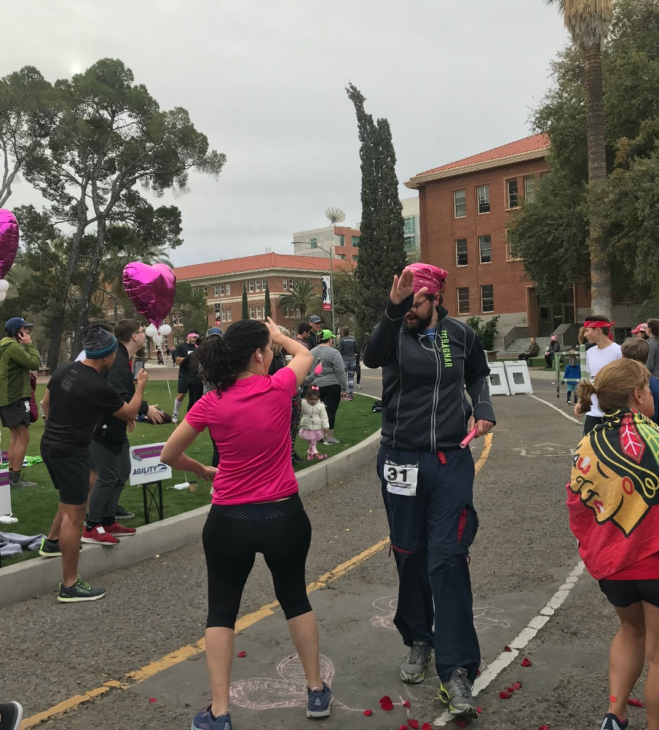
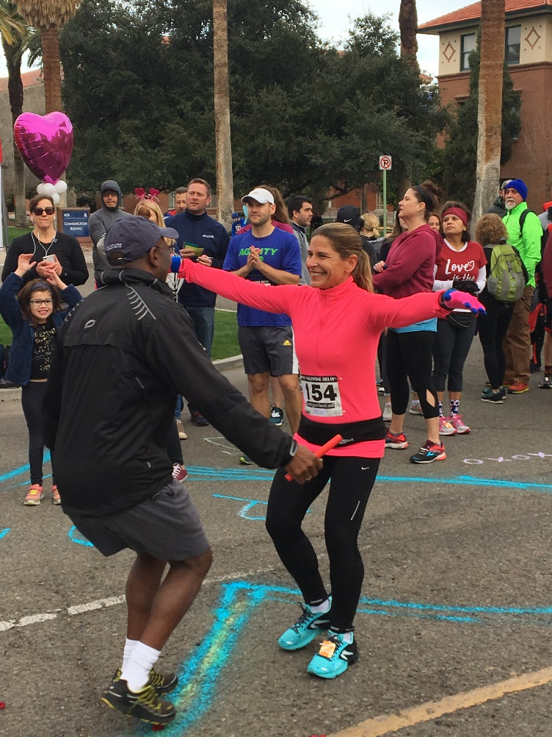
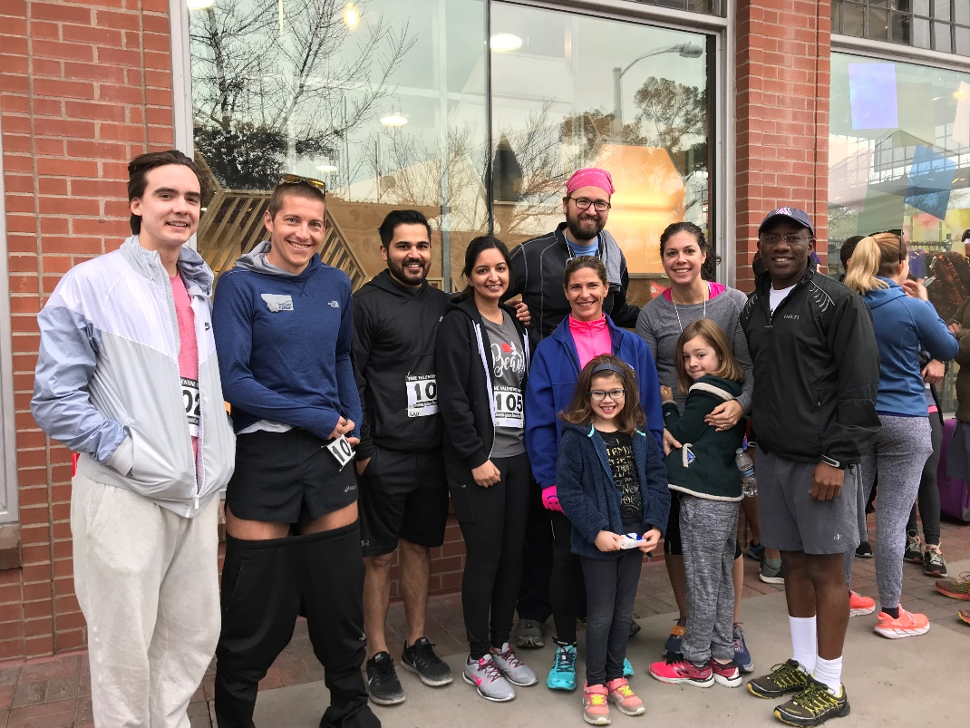
SUNDAY, FEBRUARY 9

Slide 3

February Book Club
Book: Tara Westover’s Educated
Date: Fri, Feb 28 starting at 6:30 PM
Location: Dr. Henry’s House
  6320 N Whaleback Place
RSVP/more info at: dosfebbookclub.eventbrite.com

Slide 4
Six-Word Story
Break into pairs
LISTEN for 5 min
Questions:
  What are you feeling?
  What is that about?
  What do you want?
Create a Six-Word Story; it should provide a movement of conflict, action, and resolution that gives the sense of a complete story transpiring in a moment’s reading

Slide 5
Six-Word Story
Examples:
  For sale: baby shoes, never worn.
  We’re lying in bed. She’s lying.
  Born a twin. Graduated an only child.
  Strangers. Friends. Best friends. Lovers. Strangers.
  “Male?” “It’s an old drivers license.”
  Paramedics finished her text, “…love you.”
  T.H.C., L.S.D., D.U.I., C.P.R., D.O.A., R.I.P

Slide 6
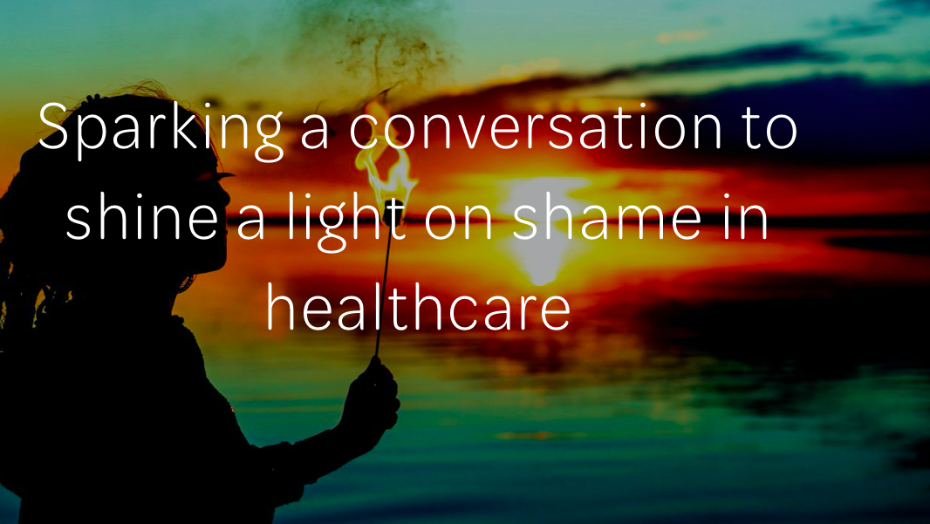

Slide 7
The Shame Conversation
What do you think shame is?
What is the difference between:
  Shame
  Guilt
  Embarrassment
  Humiliation
How do you experience shame in your day-to-day lives?

